Slide 1


TMDB MOVIE
PUCHE MENTORED BY:ASHISH RAJPUT

Slide 2


CONTENTS
INTRODUCTION
OBJECTIVES
BUSINESS OBJECTIVES
ANALYSIS
CONCLUSION

Slide 3

INTRODUCTION
The Movie Database (TMDB) is a comprehensive platform that provides information about movies and TV shows. TMDB data analysis using Python offers a fascinating journey into the realm of movies and TV shows, providing valuable insights for enthusiasts, researchers, and industry professionals alike.

Slide 4
OBJECTIVES
The objective of the project is to use Python programming to analyze a movie data to perform exploratory data analysis by answering the questions in the upcoming slides.

Slide 5


BUSINESS OBJECTIVE
Tasks :-
Display the number of rows and columns in the data. Display the titles and genres of the first 50 movies from the dataset
Identify the columns that have null values and perform null value treatment where necessary
Display the movie categories that have a budget greater than$220,000.
Display the movie categories that have a revenue greater than$961,000,000.
Remove rows with value 0 from both budget and revenue columns
List top 10 movies with the highest revenue and top 10 with the least budget
How are popularities of movies and budget related?. Are there any correlation between them?. Write your interpretations
Identify and display the names of all production companies along with the number of times they appear in the dataset
Display the names of the top 25 production companies based on the number of movies they have produced in descending order of the number of movies produced
Sort the data in descending order based on revenue and filter the top 500 movies. Find the measures of central tendency for the following columns using the filtered data:
Budget
Revenue
Runtime
Perform outlier analysis on the above three columns using boxplots.
Identify and display the names of the movies along with their runtimes for those movies that have above average runtime, using the data from the previous task

Slide 6
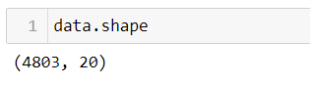
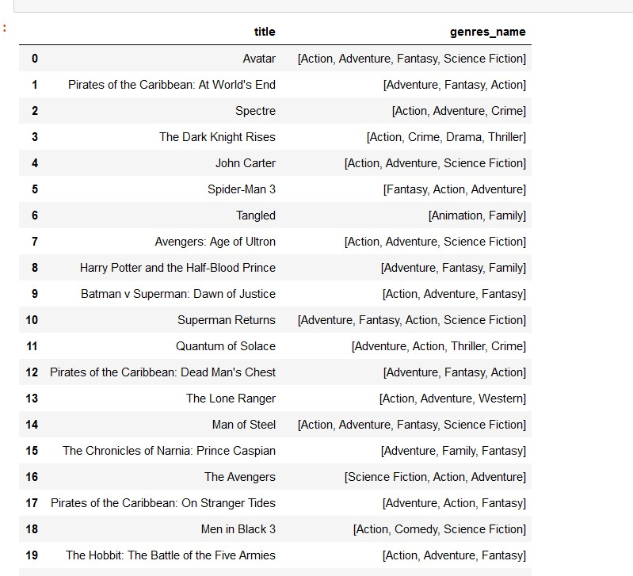
1.Display the numbers of rows and columns in the dataset. Display the titles and genres of the first 50 movies from the dataset.
There are a total of 4803 records of movies and 20 columns.
The titles and the genres of the first 50 movies, where 19 of them are shown on the screen .

Slide 7
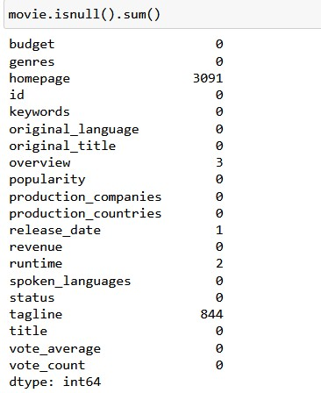
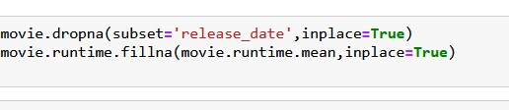
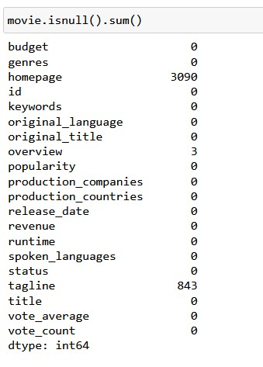
2.Identify the columns that have null values and perform the null value treatment.
After treatment
We dropped the null values from the release_date and Null value in runtime was filled by the average runtime.

Slide 8
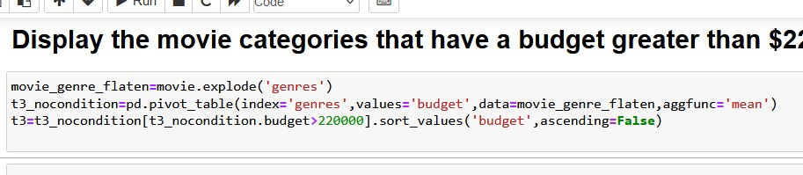
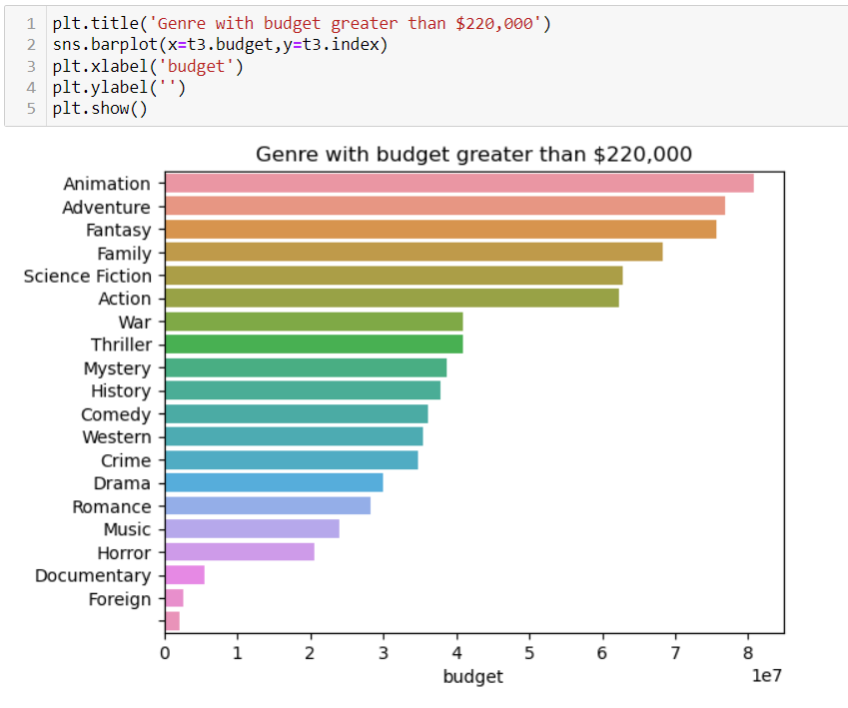
3.Display the movie categories that have a budget greater than $220,000.
There are 20 categories of movies that have budget greater than $220,000,
with Animation category having the highest budget.

Slide 9
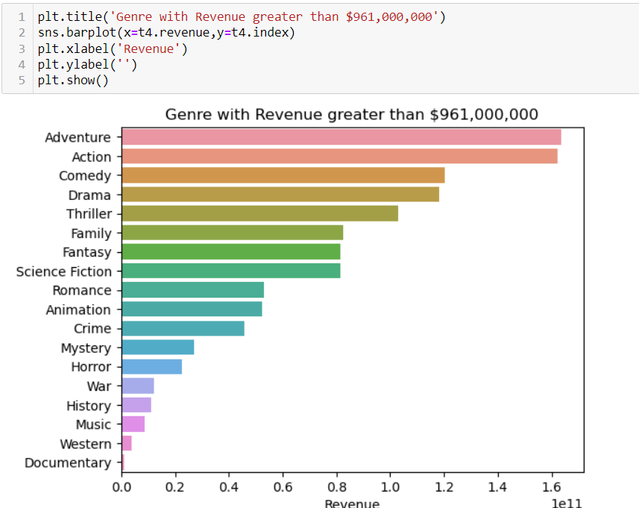
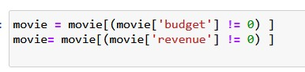
4.Display the movie categories where the revenue is greater than $961,000,000.
5.Remove the rows with value 0 from both the budget and revenue columns.
The movies with value 0 is removed from both the budget and revenue columns.
There are 18 genre whose revenue is greater than $961,000,000.
Adventure Genre with the highest revenue and
Documentary genre with the least revenue.

Slide 10
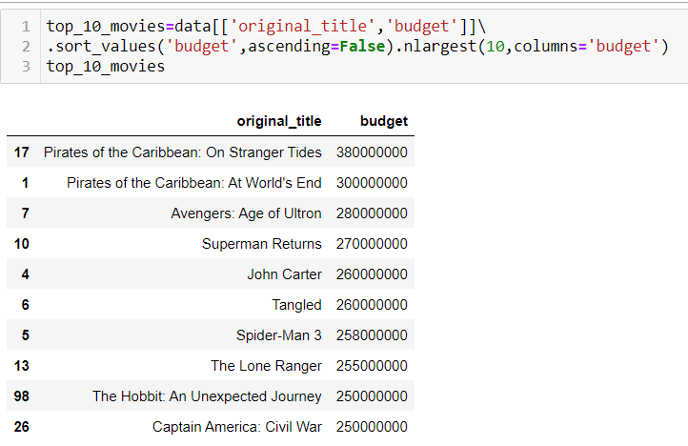
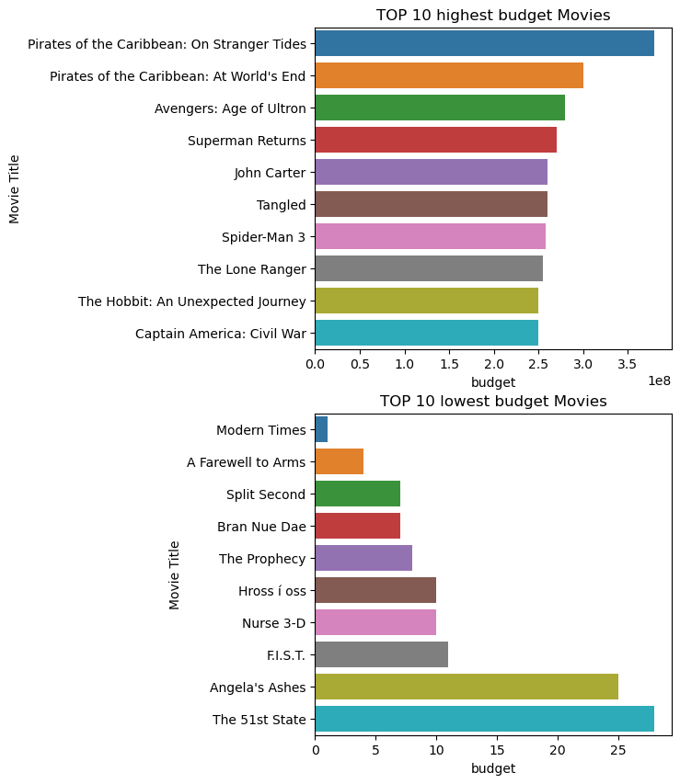
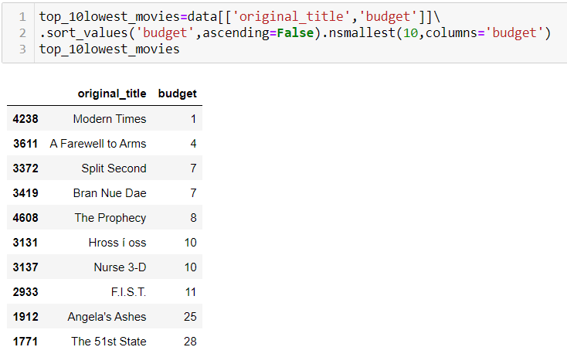
6.List the top 10 movies with the highest revenues and the top 10 movies with the least budget.
Highest revenue
Pirates of the Caribbean
is the movie with the highest budget
Least revenue
Modern Times
is the movie with the lowest budget

Slide 11
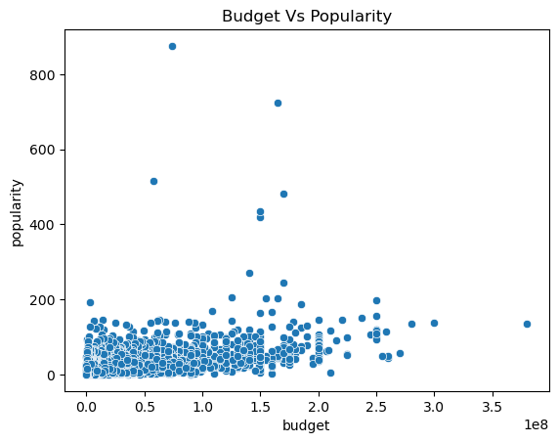
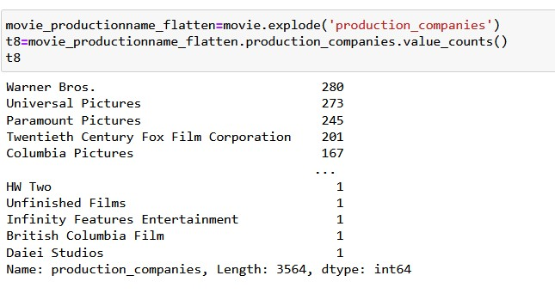
7.How are popularities of movies related with the movie budgets?
8.Display the names of all production companies along with the number of times they appear in the dataset. How are popularities of movies related with the movie budgets?
Most of the movies are made at lower budget, so, there is no correlation between the budget and popularity of the movies.
There are total 3564 movie production companies.
Warner Bros has produced the highest number of movies as per the given dataset.

Slide 12
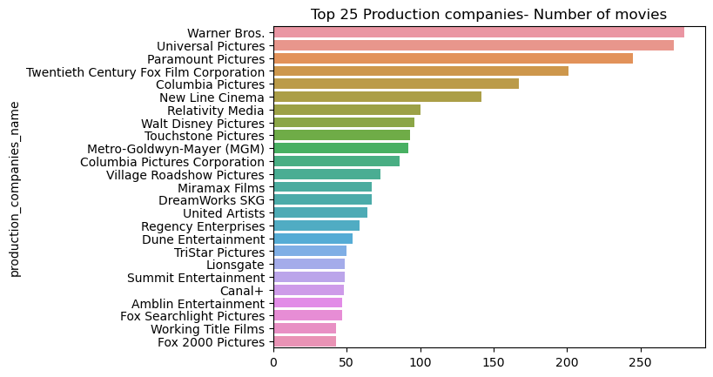
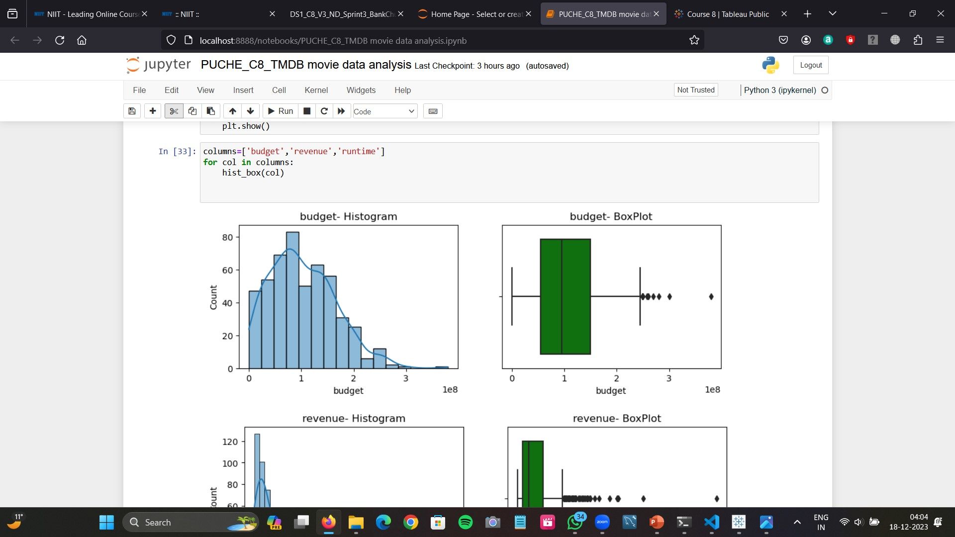
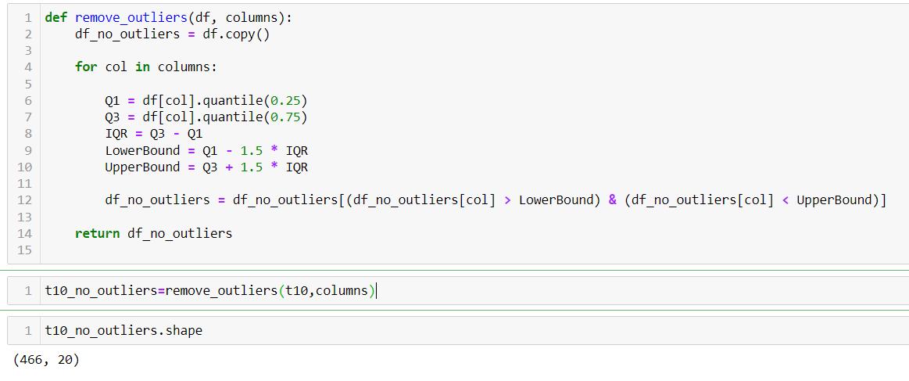
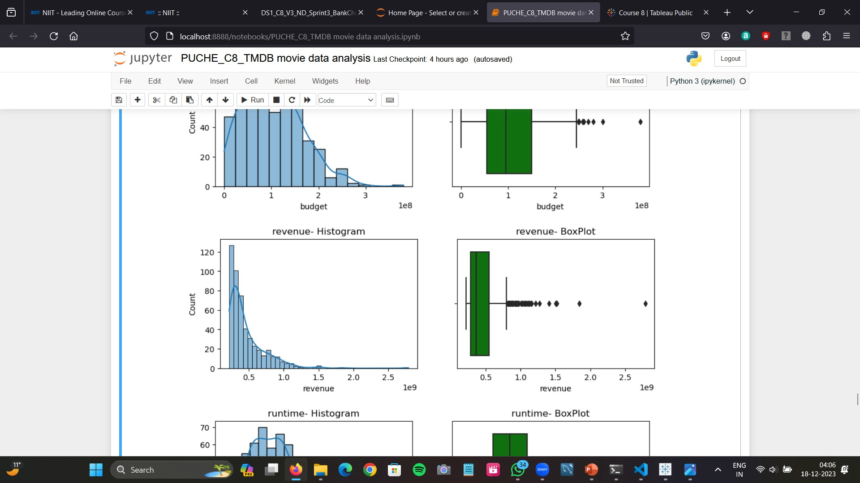
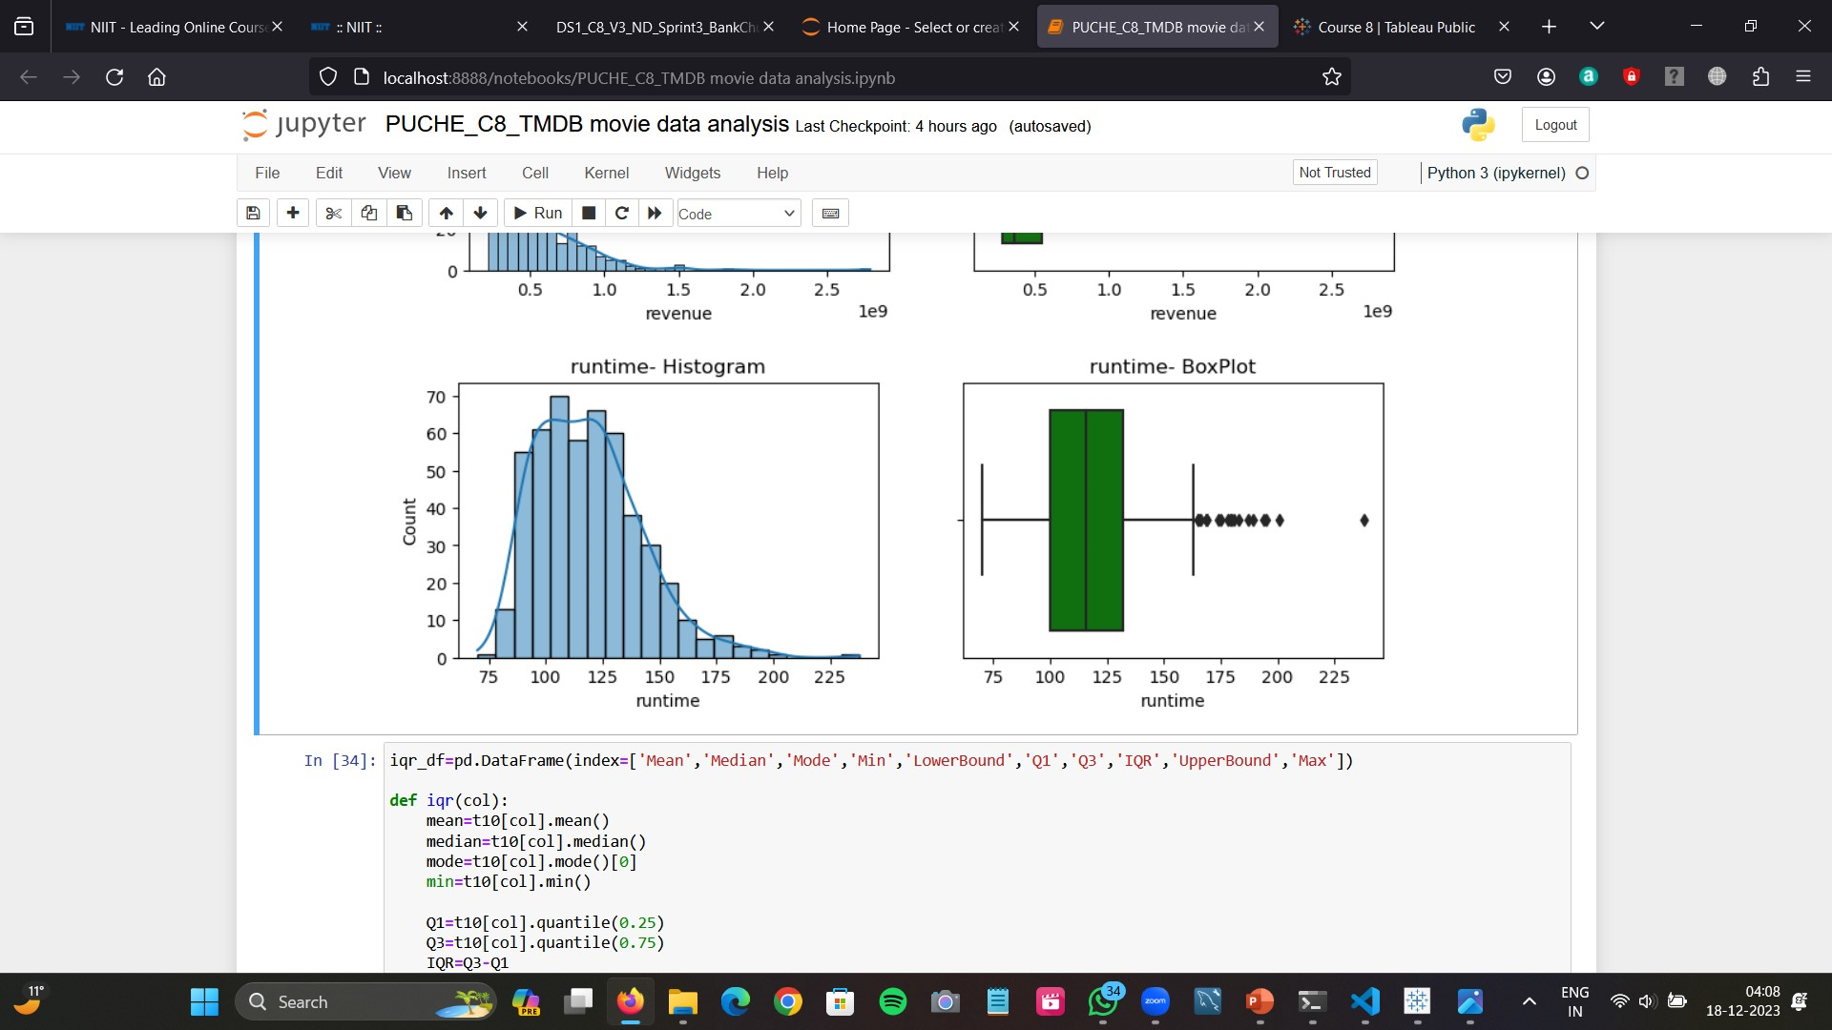
9.Display the names of the top 25 production companies based on the number of movies
10.Sort the data in descending order based on revenue and filter the top 500 movies. (Perform outlier analysis)
After performing outlier analysis ,466 movies remained out of the given 500 movies.
Warner Bros production has the highest number of movies produced.

Slide 13
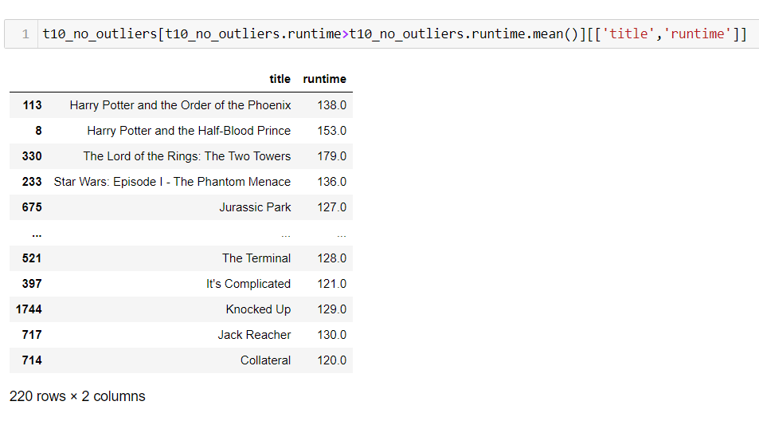
11.Identify and display the names of the movies along with their runtimes for those movies that have above average runtime, using the data from the previous task
There are 220 movies whose runtime is greater than the average runtime.

Slide 14
CONCLUSION
We addressed data by handling null values and removing rows with zero budget or revenue.
Adventure genre is one of the best revenue
generating category.
Modern Times is the least budget movie.
There are total 3564 movie production companies.
Warner bros is the best movie producing company.
Warner Bros has produced 280 movies .
There is no correlation between the budget and popularity of the movies.

Slide 15
THANKYOU

